Slide 1

Online Voting System with Aadhaar-Style OTP Verification
[REVIEW-0]
DATABASE SYSTEMS ENGINEERING AND DISTRIBUTED BACKEND DEVELOPMENT
Course Code: 25CS1302E
Section: 12
Team No.: 9
Team Members
2520090132 - Keerthana G.
2520090121 - Thota Jhana Sri
2520090126 - Sutte Alekhya

Slide 2
Introduction
Online Voting System is a web-based application designed to modernize the traditional voting process.
It provides a convenient platform for voters to cast their votes digitally.
OTP-based verification provides an additional layer of voter authentication.
Only authenticated voters can access the voting interface.
The system uses a centralized database to manage voters, candidates, elections and votes.
It also helps administrators manage elections and generate results efficiently.
Key Idea
Secure Authentication + Database Management + Online Voting

Slide 3
Problem Statement
Traditional voting systems require voters to be physically present at polling locations and involve manual verification, record maintenance, and vote counting. These processes can require significant time and effort and may make election management more complex. In an online environment, ensuring that only authorized voters can access the voting system, preventing duplicate voting, and maintaining accurate voting records are important challenges. Therefore, there is a need for a secure and user-friendly online voting system that provides voter authentication through OTP verification, maintains vote integrity, securely manages voter and election data, and enables efficient election and result management.

Slide 4
Objectives
Authenticate voters using OTP verification.
Provide a simple online voting interface.
Allow only verified voters to cast their vote.
Prevent multiple voting in the same election.
Maintain accurate voter and voting records.
Simplify election and result management.

Slide 5
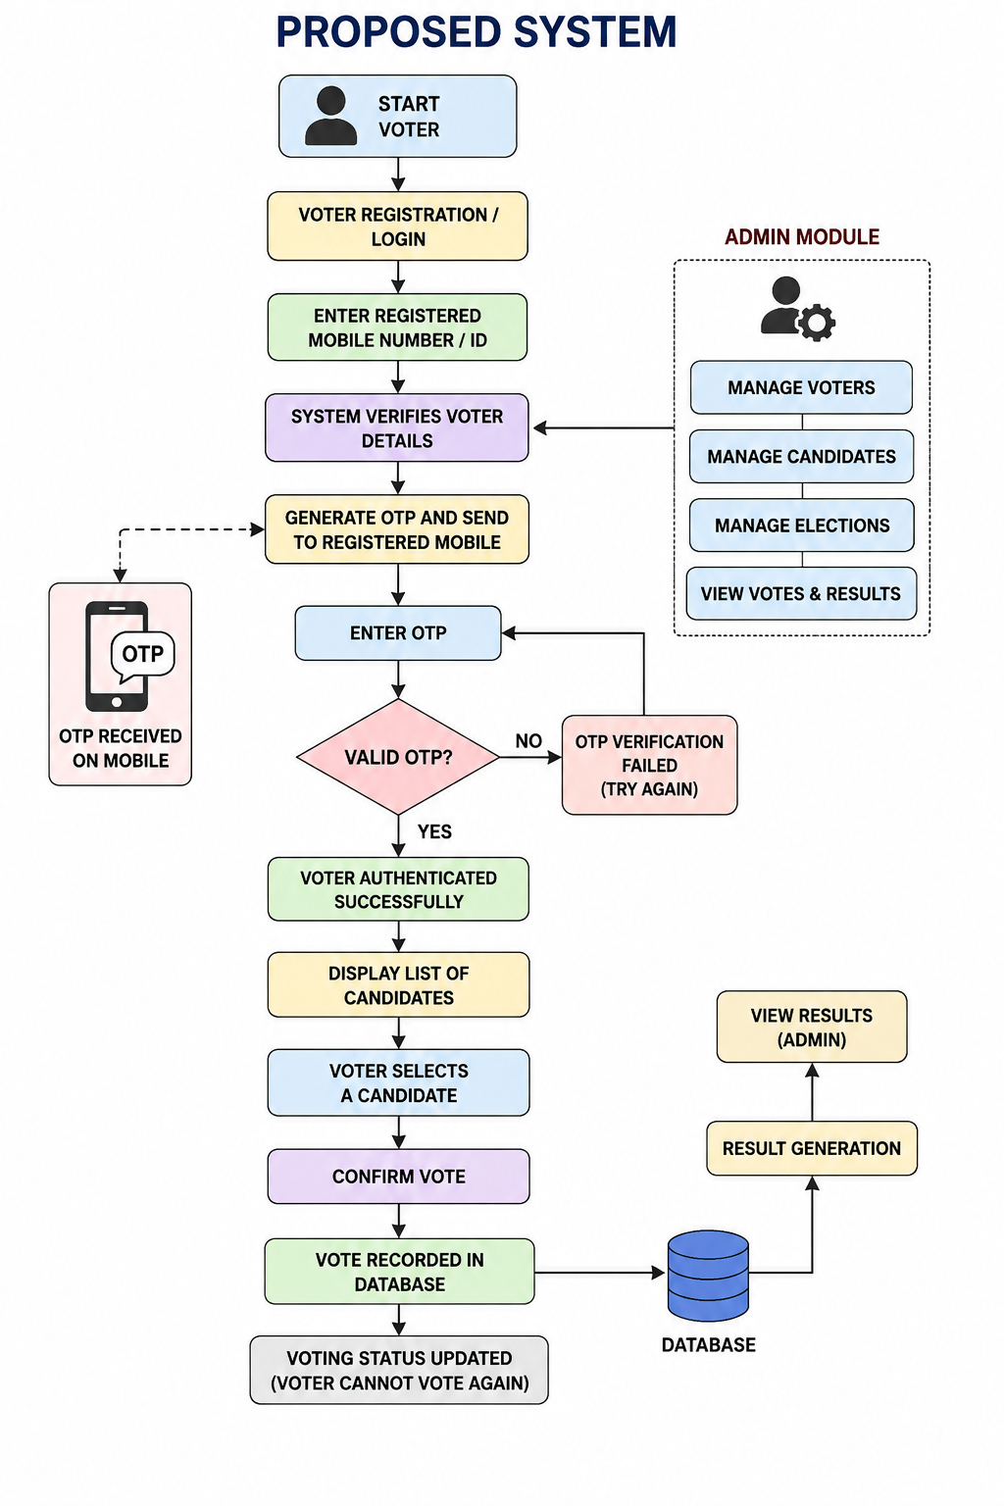
Proposed System :

Slide 6
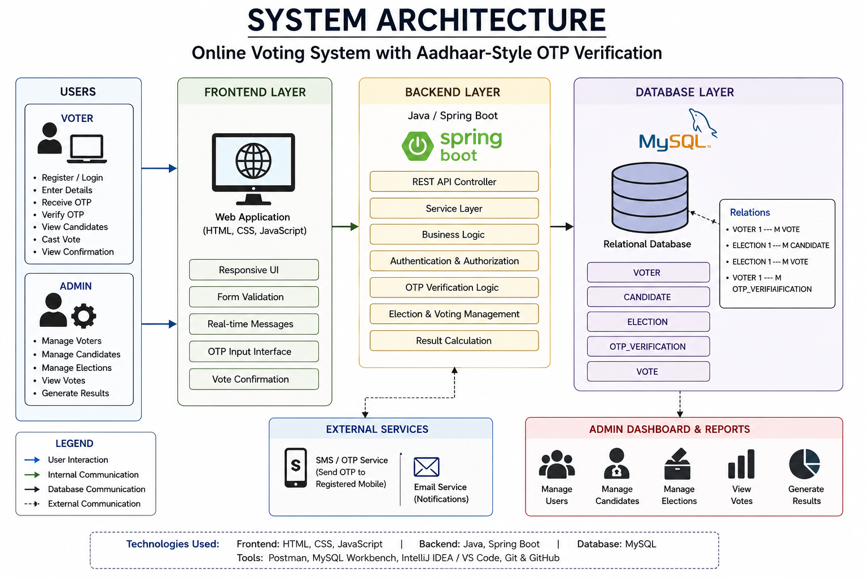

Slide 7
Database Design
Our system uses MySQL as a relational database for storing and managing voting-related information.
Main Tables:
1. Voter
voter_id — Primary Key
name
mobile_number
email
password
verification_status
voting_status
2. Candidate
candidate_id — Primary Key
name
party
election_id — Foreign Key
is_active
3. Election
election_id — Primary Key
election_name
description
start_date
end_date
status
4.OTP_Verification
otp_id — Primary Key
voter_id — Foreign Key
otp_code
otp_expiry_time
is_verified
5. Vote
vote_id — Primary Key
voter_id — Foreign Key
candidate_id — Foreign Key
election_id — Foreign Key
voting_time

Slide 8
Conclusion
The Online Voting System provides a structured digital voting workflow using:
OTP-based voter authentication.
Spring Boot backend.
MySQL relational database.
Controlled voting access.
Duplicate voting prevention.
Automated vote and result management.
The project demonstrates practical concepts from database engineering and backend development, SQL, transactions, REST APIs, authentication and database integration.

